Slide 1

LAPLACE TRANSFORM Heaviside Step Function
Guided by: Prof. Suvarna Gaikwad
-Presented by:
Hitesh meta
Aaryan anil
Sanskruti salve
Anshita vairalkar

Slide 2
Types of function in Laplace Transform are: 1)Periodic Function 2)Heaviside Function 3)Dirac Delta Function

Slide 3
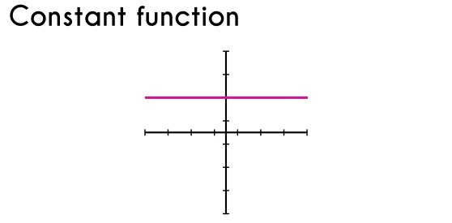
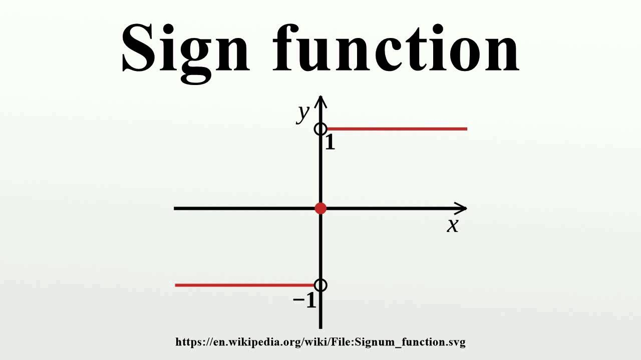
TYPES OF STEP FUNCTION
Constant function
A constant function is a trivial example of a step function. The domain of this function is the set of all real numbers R.
f(x) = c
Sign function
The Value of Function is −1 for negative numbers and +1 for positive numbers, and is the simplest non-constant step function.

Slide 4
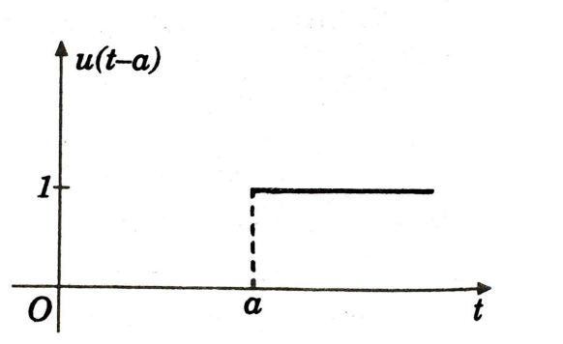
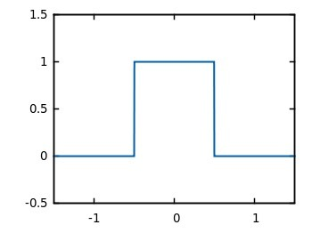
Heaviside function/Unit Step Function
Value of function is 0 for negative numbers and 1 for positive numbers.
Rectangular function
The rectangular function is a function that produces a rectangular-shaped pulse.

Slide 5
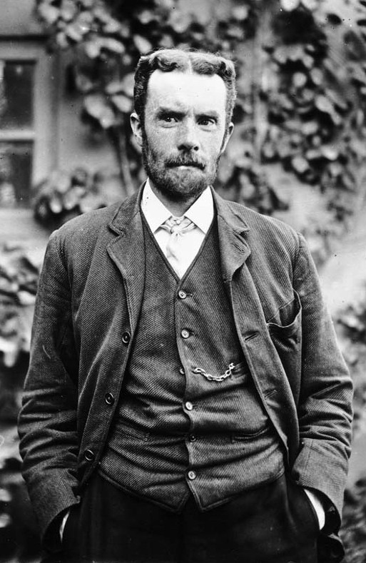
HEAVISIDE STEP FUNCTION
The Heaviside step function, or the unit step function is a step function, named after Oliver Heaviside.
HEAVISIDE STEP FUNCTION IS SUBDIVIDED INTO TWO PARTS:
Heaviside Function
Inverse Heaviside Function

Slide 6
HEAVISIDE STEP FUNCTION
The value of which is zero for negative arguments and one for positive arguments. Usually denoted by H or θ.
The function was originally developed in operational calculus for the solution of differential equations, where it represents a signal that switches on at a specified time and stays switched on indefinitely.

Slide 7
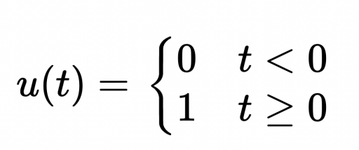
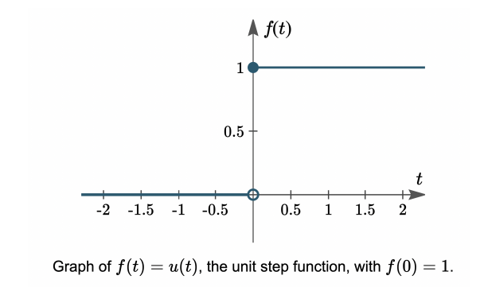
WHAT IS A UNIT STEP FUNCTION?
UNIT STEP FUNCTION
One common example is when a voltage is switched on or off in an electrical circuit at a specified value of time t.
The value of t = 0 is usually taken as a convenient time to switch on or off the given voltage.
The switching process can be described mathematically by the function called the Unit Step Function.
U is a function of time t, and u has value zero when time is negative (before we flip the switch) and value one when time is positive (from when we flip the switch).

Slide 8
SHIFTED UNIT STEP FUNCTION
A function which has value 0 up to the time t=a and thereafter has value 1

Slide 9
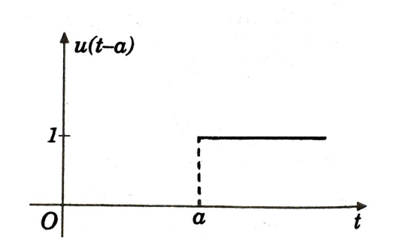

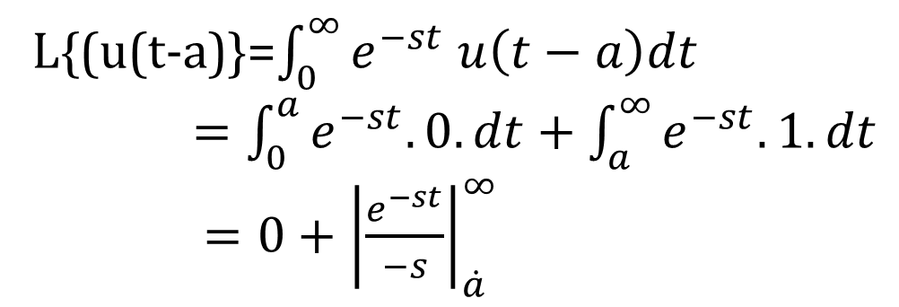
THEOREM
FINDING TRANSFORM OF A UNIT FUNCTION
L{(u(t-a)}=$\int_{0}^{∞}{e^{−st} u\left(t−a\right)dt}$
$=\int_{0}^{a}{e^{−st}.0.dt+\int_{a}^{∞}{e^{−st}.1.dt}}$
$=0+{\left|\frac{ⅇ^{−st}}{−s}\right|}_{\dot{a}}^{∞}$
Thus L{(u(t-a)}=$e^{−as}/s$

Slide 10
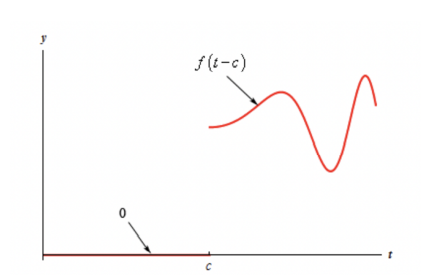

SECOND SHIFTING PROPERTY
If $L\left\{f\left(t\right)\right\}$=$\overline{f}\left(s\right)$,then
L$\left\{f\left(t−a\right)⋅u\left(t−a\right)\right\}$=$ⅇ^{−as}\overline{f}\left(s\right)$
L$\left\{f\left(t−a\right)⋅u\left(t−a\right)\right\}=\int_{0}^{∞}{e^{−st}f\left(t−a\right).u\left(t−a\right)dt}$
$=\int_{0}^{a}{e^{−st}f\left(t−a\right)\left(0\right)ⅆt}+\int_{a}^{∞}{ⅇ^{−st}f\left(t−a\right)ⅆt }$
$Put t−a=u$
$$Then dt=dx$$
$$And when t=a,x=0$$
$$when t=∞,x=∞$$
$=\int_{0}^{∞}{e^{−s\left(u+a\right)}}.f\left(u\right)du$
$=e^{−sa}\int_{0}^{∞}{e^{−su}}f\left(u\right)du$
$=ⅇ^{−sa}⋅\overline{f}\left(s\right)$

Slide 11
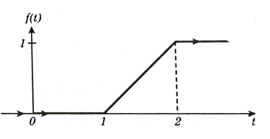
EXAMPLE:
Express the following function in terms of Unit Step Function and find its Laplace Transform.

Slide 12
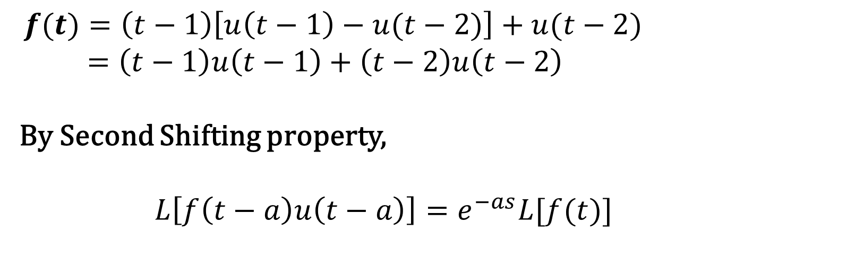
SOLUTION:
0 ,0<t<1
t - 1 ,1<t<2
1 ,t >2
We have f(t) =
$f(t)=\left(t−1\right)\left[u\left(t−1\right)−u(t−2)\right]+u(t−2)$
$=\left(t−1\right)u\left(t−1\right)+\left(t−2\right)u\left(t−2\right)$
By Second Shifting property,
$L\left[f\left(t−a\right)u\left(t−a\right)\right]=e^{−as}L[f(t)]$

Slide 13
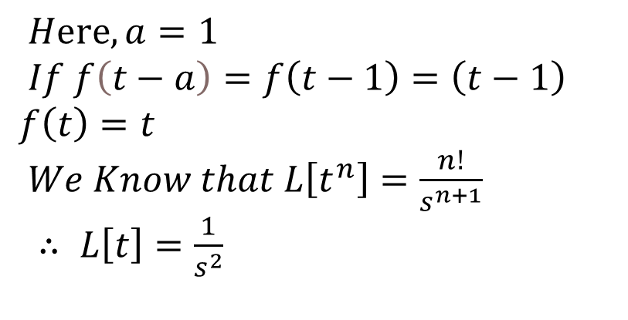

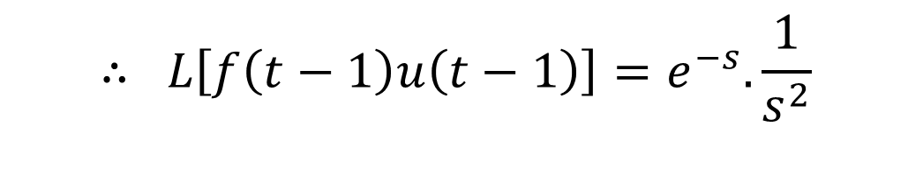
$$For , L\left[f\left(t−1\right)u\left(t−1\right)\right]$$
$Hⅇrⅇ,a=1$
$If f\left(t−a\right)=f\left(t−1\right)=\left(t−1\right)$
$$f\left(t\right)=t$$
$We Know that L\left[t^{n}\right]=\frac{n!}{s^{n+1}}$
$∴ L\left[t\right]=\frac{1}{s^{2}}$
$$∴ L\left[f\left(t−1\right)u\left(t−1\right)\right]=e^{−s}.\frac{1}{s^{2}}$$
(1)

Slide 14
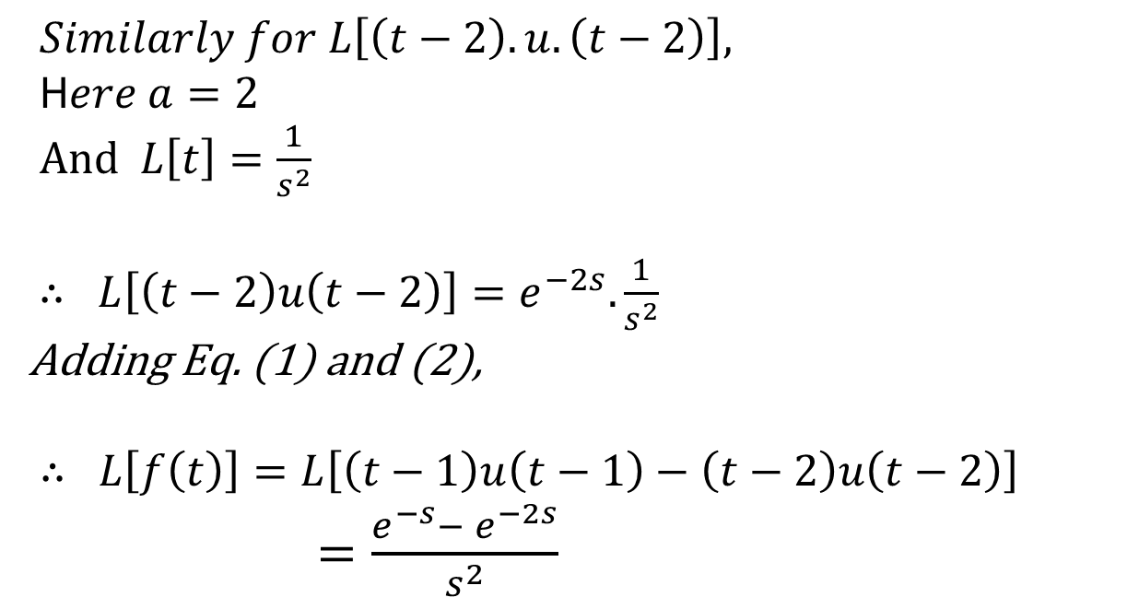
$Similarly for L\left[\left(t−2\right).u.\left(t−2\right)\right],$
H$ere a=2$
$And L\left[t\right]=\frac{1}{s^{2}}$
$∴ L\left[\left(t−2\right)u\left(t−2\right)\right]=e^{−2s}.\frac{1}{s^{2}}$
Adding Eq. (1) and (2),
$∴ L\left[f\left(t\right)\right]=L\left[\left(t−1\right)u\left(t−1\right)−\left(t−2\right)u\left(t−2\right)\right]$
$=\frac{e^{−s}− e^{−2s}}{s^{2}}$
(2)
Main Conclusion:
The conclusion is The function is used in the mathematics of control theory to represent a signal that switches on at a specified time, and which stays switched on indefinitely.

Slide 15
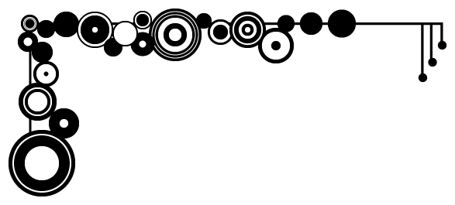
THANKYOU!

